Slide 1
15
Game Programming and Graphics in C with Allegro

Slide 2
One picture is worth ten thousand words.
  Chinese proverb
Treat nature in terms of the cylinder, the sphere, the cone, all in perspective.
  Paul Cezanne
Nothing ever becomes real till it is
experienced—even a proverb is no
proverb to you till your life has
illustrated it.
  John Keats

Slide 3
OBJECTIVES
In this chapter you will learn:
How to install the Allegro game programming library to work with your C programs.
To create games using Allegro.
To use Allegro to import and display graphics.
To use the "double buffering" technique to create smooth animations.
To use Allegro to import and play sounds.
To have Allegro recognize and deal with keyboard input.
To create the simple game "Pong" with Allegro.
To use Allegro timers to regulate the speed of a game.
To use Allegro datafiles to shorten the amount of code in a program.
The many other features Allegro can add to a game.

Slide 4
15.1 Introduction
15.2 Installing Allegro
15.3 A Simple Allegro Program
15.4 Simple Graphics: Importing Bitmaps and Blitting
15.5 Animation with Double Buffering
15.6 Importing and Playing Sounds
15.7 Keyboard Input
15.8 Fonts and Displaying Text
15.9 Implementing the Game of Pong
15.10 Timers in Allegro
15.11 The Grabber and Allegro Datafiles
15.12 Other Allegro Capabilities
15.13 Allegro Internet and Web Resources

Slide 5
15.1 Introduction
Allegro
  C library created to aid in the development of games
  Created in 1995 by Shawn Hargreaves
  Adds many game-related features to C
    Importing, displaying, and animating graphics
    Playing sounds
    Keyboard input
    Outputting text graphically
    Timers that call functions at regular intervals
  In this chapter we will program the game “Pong” to demonstrate all of Allegro’s capabilities

Slide 6
15.2 Installing Allegro
Allegro must be installed before it can be used with C
  The installation process differs slightly for different systems
  Detailed instructions in the book and the Allegro documentation

Slide 7
15.3 A Simple Allegro Program
Every Allegro program must have three components:
  #include <allegro.h>
  allegro_init
  END_OF_MAIN
#include <allegro.h>
  allegro.h header contains all Allegro function prototypes and variable type definitions
  Header must be included or Allegro program will not compile

Slide 8
15.3 A Simple Allegro Program
allegro_init
  Initializes Allegro library
  Must be present in all Allegro programs, and must be called before any other Allegro functions can be used
END_OF_MAIN
  Macro that must be placed immediately after the closing brace of main function
  Ensures Allegro executable file will run on all systems
  Required for an Allegro program to run on Windows, some UNIX systems, and Mac OS X
  Not required on other systems, but recommended to ensure cross-platform compatibility

Slide 9
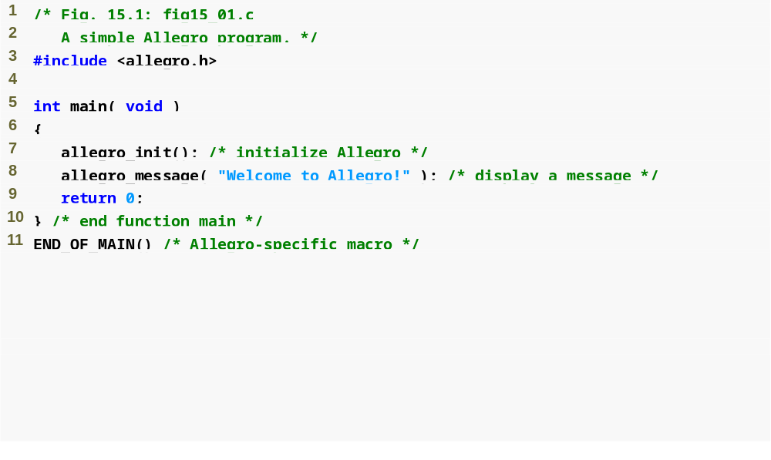
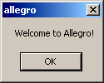
Outline
allegro.h header must be included
allegro_init function initializes Allegro library
fig15_01.c
allegro_message function displays a text message in a dialog box like this
END_OF_MAIN macro ensures program will run on all systems

Slide 10
15.4 Importing Graphics and Blitting
Importing Graphics
  Allegro can draw simple lines and shapes on its own
  More complicated graphics usually come from external files
  Allegro can load data from image files into memory and defines several variable types to point to this data
  BITMAP* type is most basic variable type for pointing to image data
BITMAP* type
  Almost always declared as a pointer
  Is a pointer to a struct
    In addition to image data, the struct contains two integers, w and h, that correspond to the bitmap’s width and height, respectively
  The screen is considered a BITMAP* by Allegro

Slide 11
15.4 Importing Graphics and Blitting
Manipulating bitmaps
  Allegro defines several functions for manipulating BITMAP* objects
  Most important: load_bitmap and destroy_bitmap
load_bitmap
  Loads image data and returns a BITMAP* that points to the data
  Takes two arguments—filename of the image and a palette
    Palette usually unnecessary; almost always passed as NULL
  Returns a BITMAP* that points to the image data or NULL if the file cannot be loaded (no runtime error will occur)

Slide 12
15.4 Importing Graphics and Blitting
destroy_bitmap
  Removes image data from memory and frees that memory for future allocation
  Takes a BITMAP* as an argument
  Once a bitmap has been destroyed, it cannot be used unless it is loaded again
  Important to destroy all bitmaps once they are no longer needed to prevent memory leaks
Other bitmap manipulation functions
  Described on next slide

Slide 13
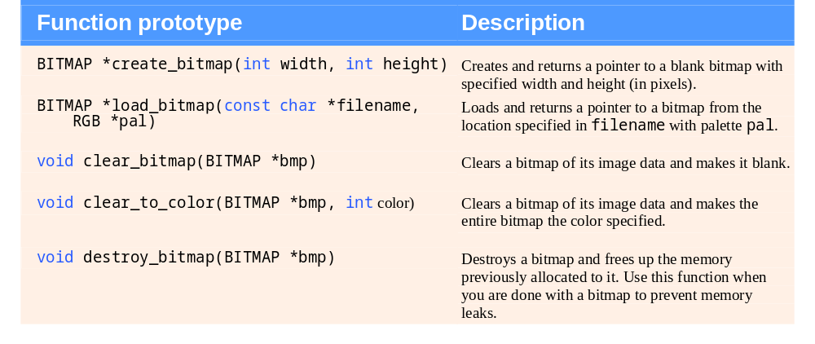
Fig. 15.2 | Important BITMAP functions.

Slide 14
Common Programming Error 15.1
Telling Allegro to load a file that is not in the same folder as the program being run will cause a runtime error, unless you specifically tell the program the folder in which the file is located by typing the full path name.

Slide 15
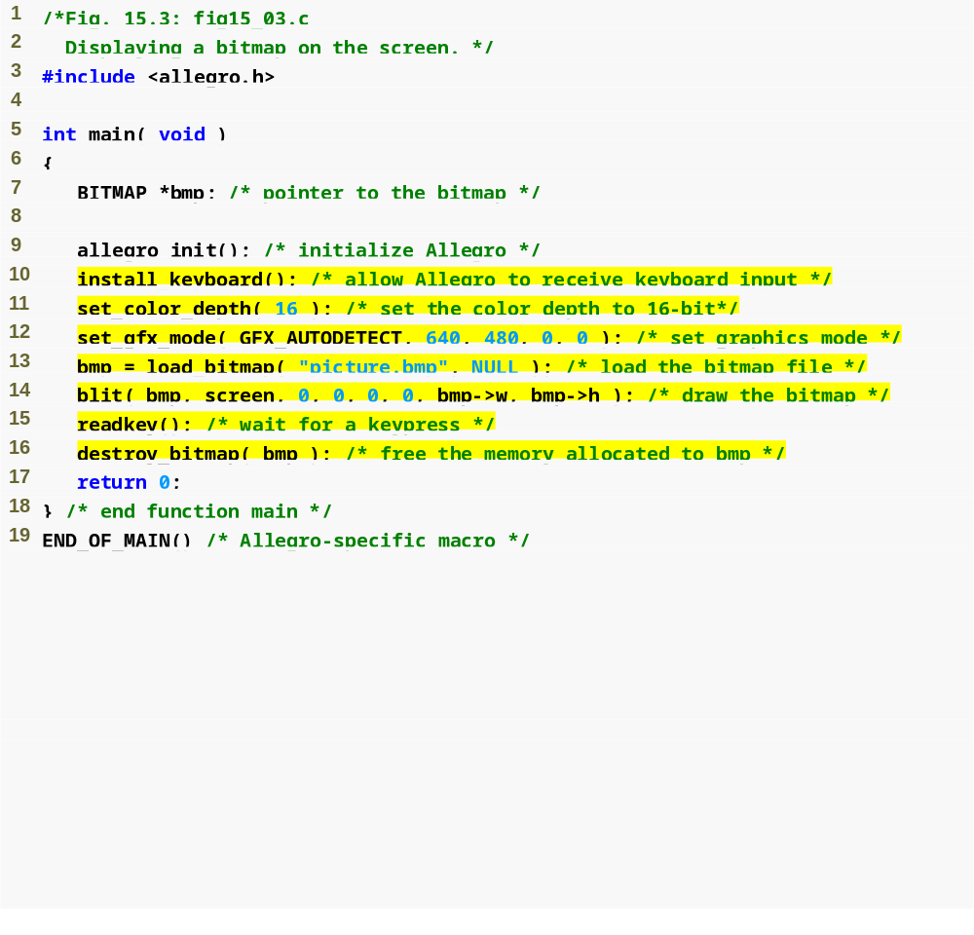
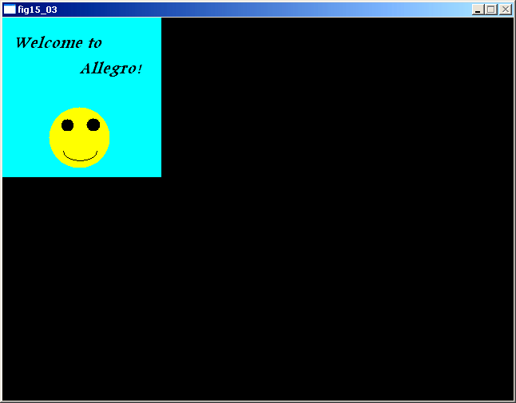
Outline
install_keyboard allows Allegro to receive keyboard input
fig15_03.c
load_bitmap loads picture.bmp into memory and has bmp point to its data
readkey forces program to wait for a keypress
destroy_bitmap removes bmp from memory
blit draws bmp onto the top left corner of the screen

Slide 16
15.4 Importing Graphics and Blitting
Setting up graphics mode
  Before any graphics can be displayed, Allegro must set the graphics mode
  Performed with two functions: set_color_depth and set_gfx_mode
set_color_depth
  Must be called before set_gfx_mode
  Takes an integer as an argument
  Sets color depth of the program
    Color depth specifies how many bits of memory are used by the program to store the color of one pixel
  Color depth can be set to 8-, 15-, 16-, 24-, or 32-bit
  8-bit not recommended as it complicates the image-loading process

Slide 17
15.4 Importing Graphics and Blitting
set_gfx_mode
  Sets graphics mode of the program
  Takes five arguments, all integers
  First argument specifies the graphics card driver Allegro should use for graphics
  Should be passed a symbolic constant defined by Allegro
  These constants are known as the graphics “magic drivers”
    GFX_AUTODETECT_FULLSCREEN sets program to fullscreen mode
    GFX_AUTODETECT_WINDOWED sets program to windowed mode
    GFX_AUTODETECT tells program to try fullscreen mode and then windowed mode if fullscreen fails
    GFX_SAFE is identical to GFX_AUTODETECT, but if both fullscreen and windowed mode fail to work, will set program to a low-quality “safe” graphics mode

Slide 18
15.4 Importing Graphics and Blitting
set_gfx_mode
  Second and third arguments determine width and height (in pixels) of graphics mode, respectively
  Last two arguments determine minimum size of the “virtual screen”—usually set to 0
    In current version of Allegro, virtual screen has no effect on the program, so these arguments can essentially be ignored
  Returns 0 if graphics mode is set successfully, or a non-zero value otherwise

Slide 19
15.4 Importing Graphics and Blitting
blit
  Stands for “BLock Transfer”
  Most important graphics function
  Takes a rectangular block of one bitmap and draws it onto another
  Takes eight arguments—two BITMAP*s and six integers
  First argument specifies the bitmap from which the block will be taken
  Second argument specifies the bitmap onto which the block will be drawn
    To specify the screen, use the symbolic constant screen

Slide 20
15.4 Importing Graphics and Blitting
blit
  Third and fourth arguments specify the x- and y-coordinates of the top-left corner of the block to be taken from the source bitmap
  Fifth and sixth arguments specify the x- and y-coordinates on the destination bitmap onto which the top-left corner of the block will be drawn
  Seventh and eighth arguments specify the width and height, respectively, of the block to be taken from the source bitmap
  Note that in Allegro, the coordinates (0, 0) represent the top left corner of the screen or bitmap
    A larger y-coordinate means further down on the screen, not up

Slide 21
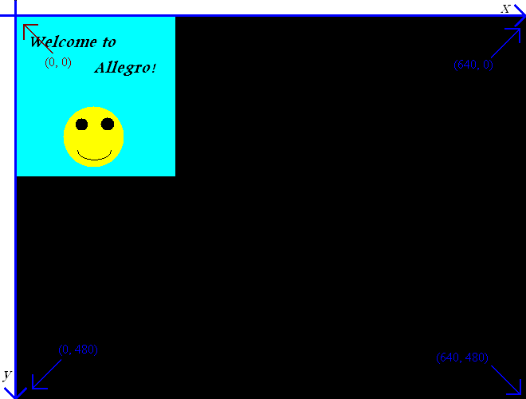
Fig. 15.4 | Allegro’s coordinate system.

Slide 22
Software Engineering Observation 15.1
Avoid using the GFX_SAFE "magic driver" if possible. The "safe" graphics modes generally have a negative impact on your program’s appearance.

Slide 23
Common Programming Error 15.2
Loading a bitmap before setting the color depth and graphics mode of a program will likely result in Allegro storing the bitmap incorrectly.

Slide 24
Error-Prevention Tip 15.1
Use the destroy_bitmap function to free up the memory of a bitmap that is no longer needed and prevent memory leaks.

Slide 25
Common Programming Error 15.3
Trying to destroy a bitmap that has not been initialized causes a runtime error.

Slide 26
15.5 Animation with Double Buffering
Animation
  Very simple in Allegro
  Draw one “frame” of animation, then clear the screen and draw next “frame”
Pong
  At this point we start programming Pong
  Our “ball” will only travel in four directions—up-left, up-right, down-left, and down-right

Slide 27
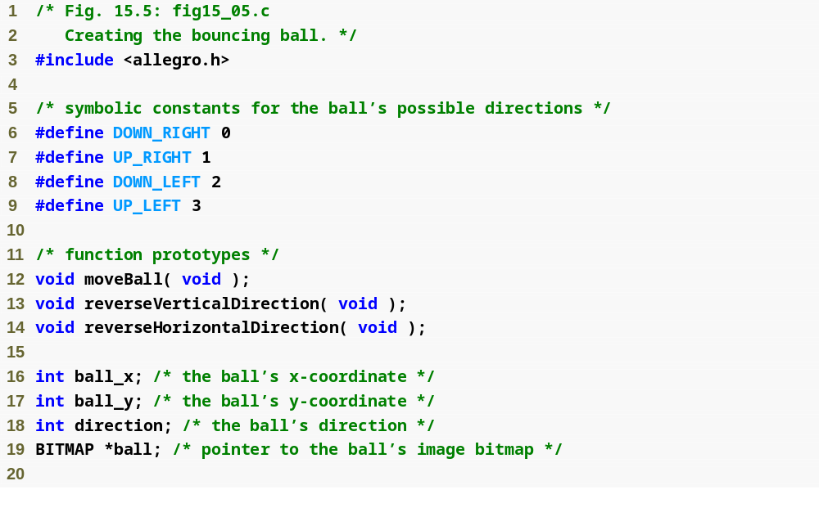
Outline
fig15_05.c
(1 of 4 )
These symbolic constants correspond to the ball’s four possible directions of travel

Slide 28
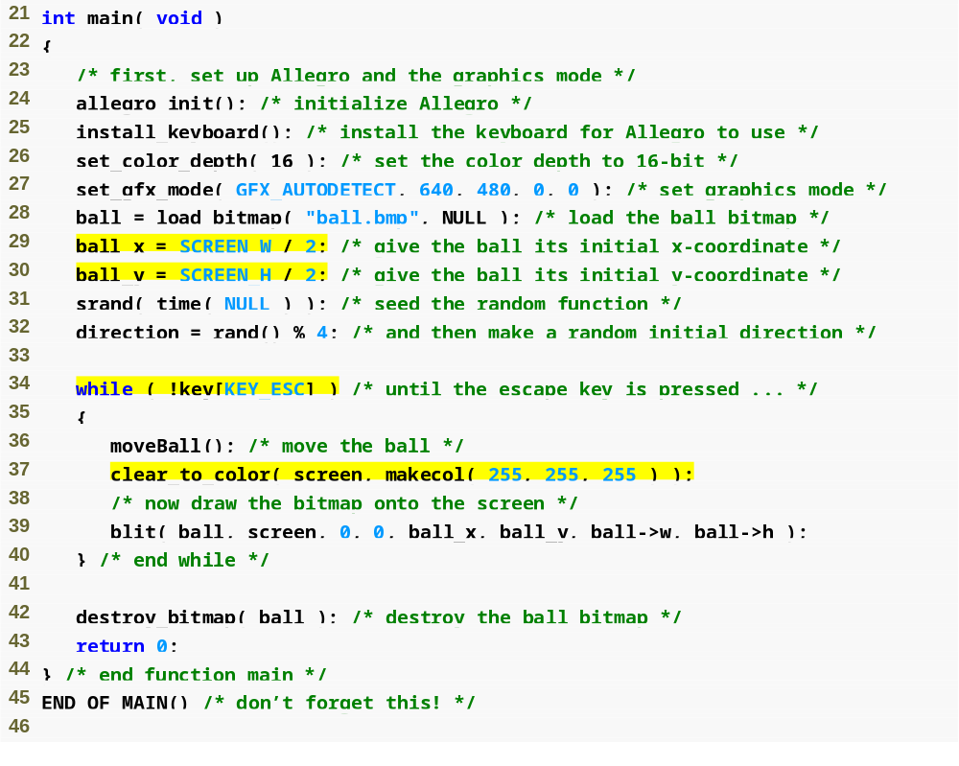
Outline
fig15_05.c
(2 of 4 )
SCREEN_W and SCREEN_H correspond to the width and height of the screen
clear_to_color function clears the entire screen to white

Slide 29
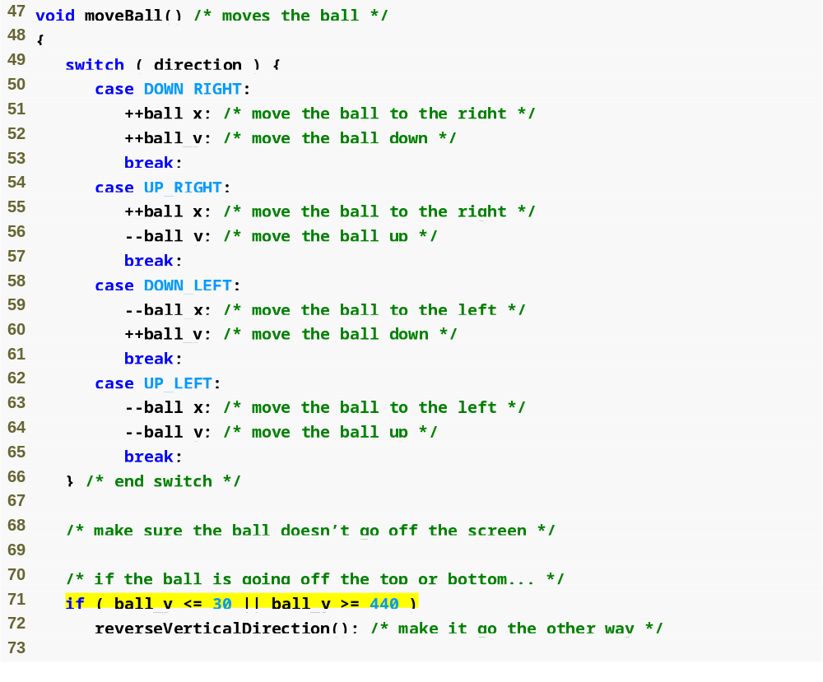
moveBall function moves the ball according to the value of direction variable
Outline
fig15_05.c
(3 of 4 )
if statement tells program to reverse the ball’s horizontal direction if it touches the top or bottom of the screen

Slide 30
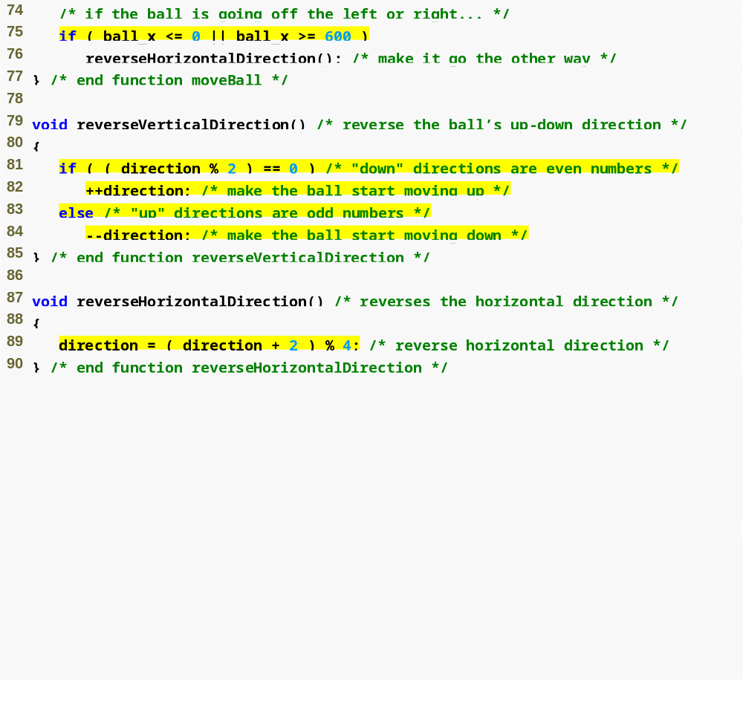
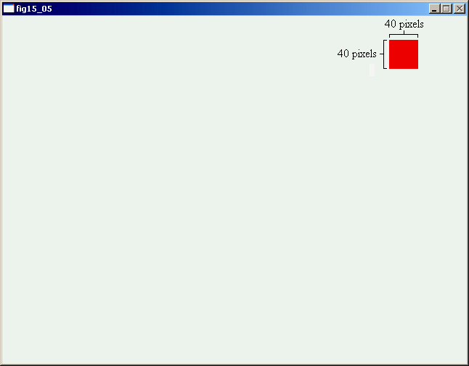
Outline
if statement also reverses vertical direction
fig15_05.c
(4 of 4 )

Slide 31
15.5 Animation with Double Buffering
while( !key[ KEY_ESC ] )
  Allegro defines the key array that stores the state of each key on the keyboard
  key[KEY_ESC] corresponds to the state of the Esc key
  Program will continue while Esc is not being pressed
makecol
  Returns an integer that Allegro interprets as a color
  Takes three integers—a red intensity, a green intensity, and a blue intensity
  Each intensity can vary from 0 (none) to 255 (maximum)

Slide 32
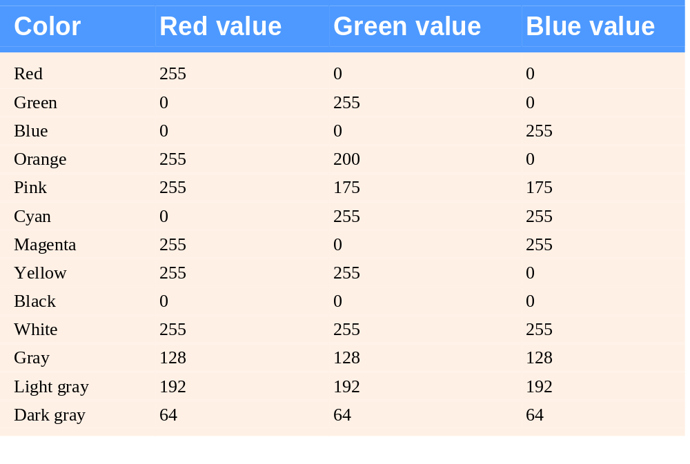
Fig. 15.6 | The red, green, and blue intensities of common colors in Allegro.

Slide 33
15.5 Animation with Double Buffering
Double Buffering
  In previous program, the ball often appears to flicker due to the screen constantly clearing itself to white
  Double buffering removes this flicker
  Uses an intermediary bitmap called the “buffer” that is the size of the screen
  Anything meant to be drawn on the screen is drawn on the buffer instead
  Once everything is on the buffer, the program then draws the buffer over the entirety of the screen
  The buffer bitmap is cleared after it is drawn on the screen

Slide 34
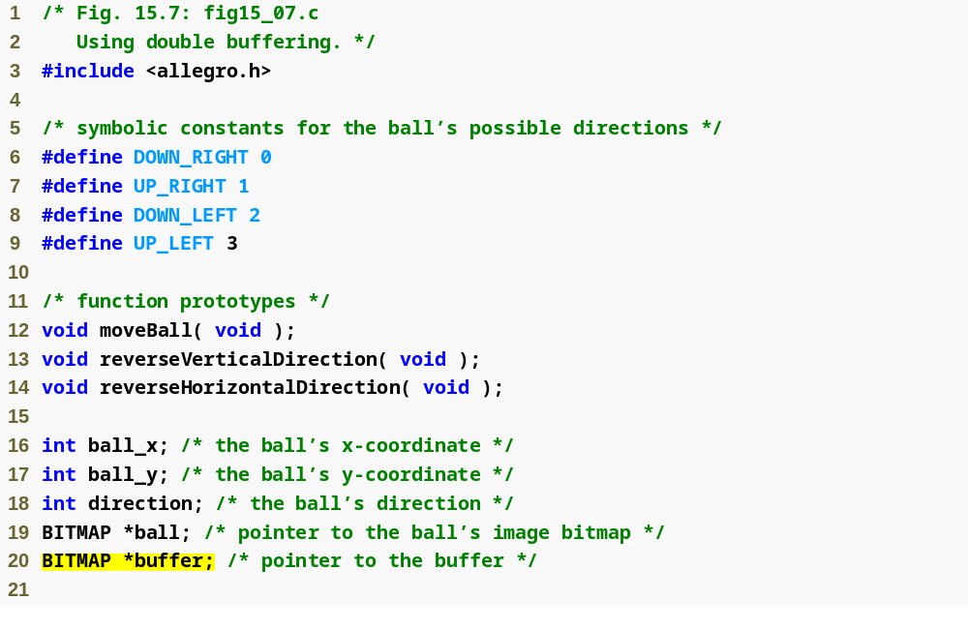
Outline
fig15_07.c
(1 of 4 )
buffer bitmap is defined as a global variable

Slide 35
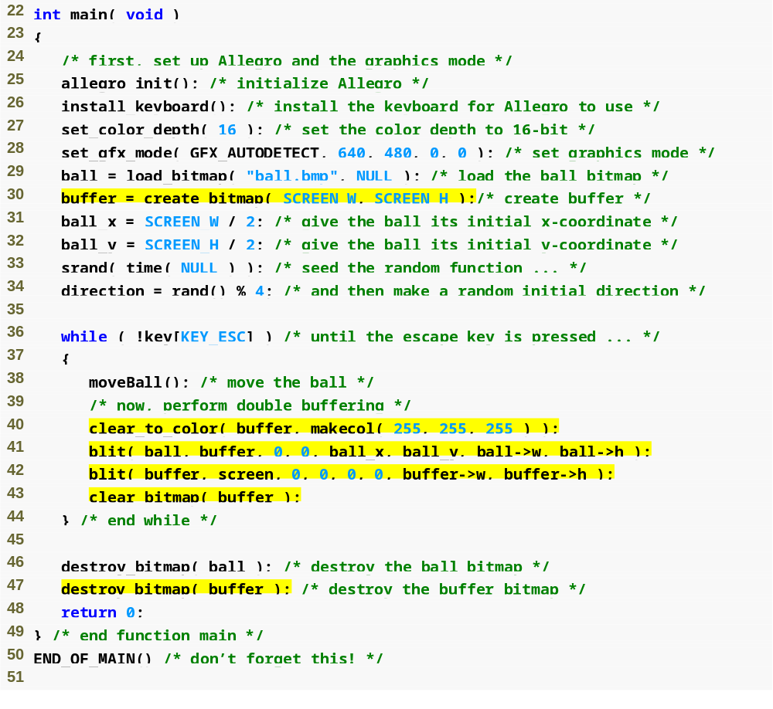
Outline
fig15_07.c
(2 of 4 )
buffer is created to be the size of the screen
The ball is drawn onto the buffer, and then the buffer is drawn onto the screen
Buffer bitmap must also be destroyed at program’s end

Slide 36
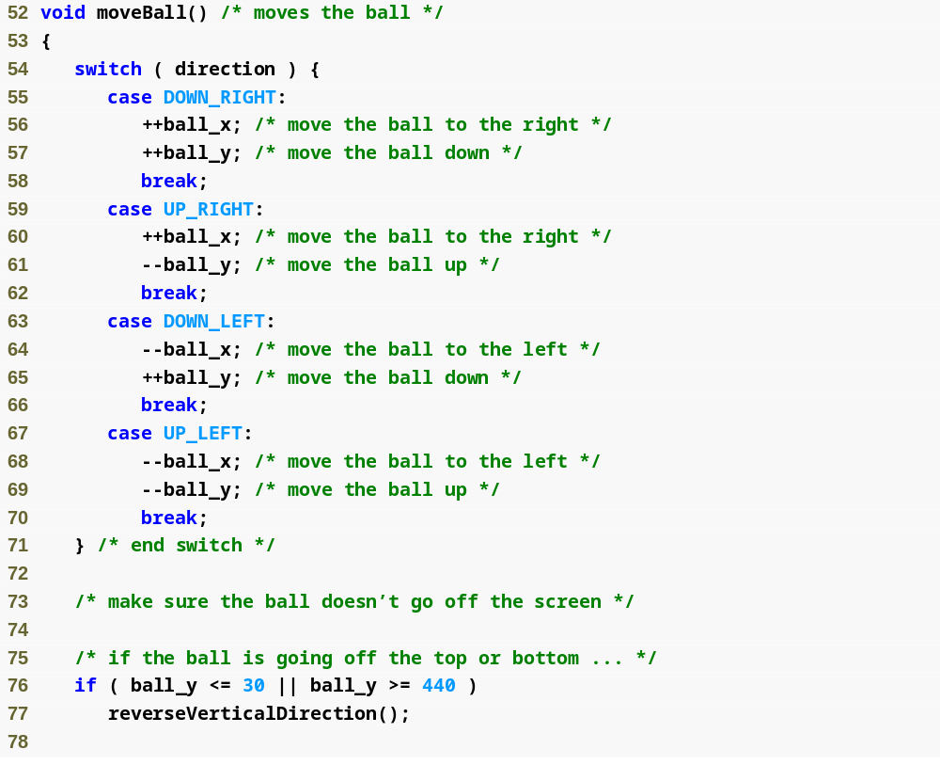
Outline
fig15_07.c
(3 of 4 )

Slide 37
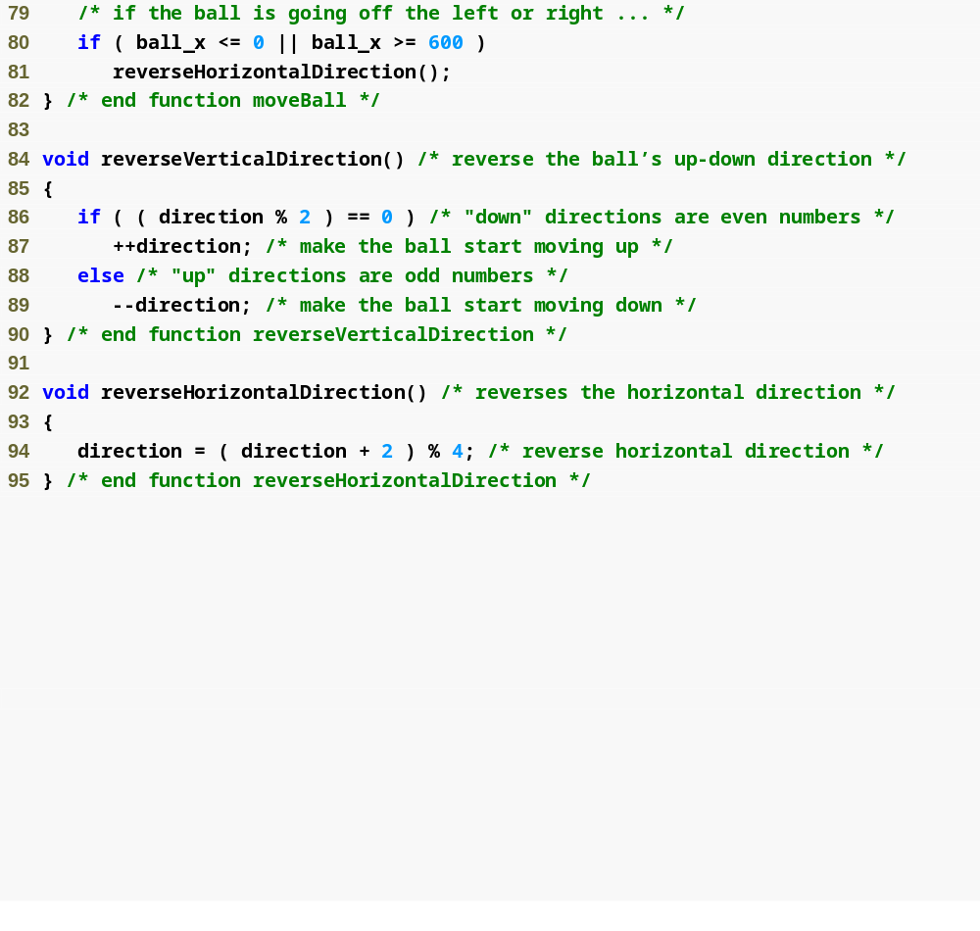
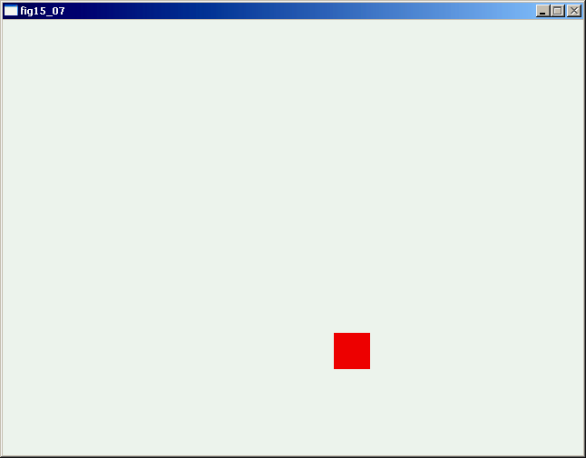
Outline
fig15_07.c
(4 of 4 )

Slide 38
15.6 Importing and Playing Sounds
Importing Sounds
  Importing sounds is done in a way similar to that of importing images
  Main Allegro variable type for storing sound data is type SAMPLE*
    Short for “digital sample”
load_sample
  As load_bitmap loads bitmaps, load_sample loads sounds
  Takes one argument—the filename of the sound
  Returns a SAMPLE* or NULL if the sound cannot be loaded

Slide 39
15.6 Importing and Playing Sounds
play_sample
  Plays a SAMPLE* that has been loaded into the program
  Takes five arguments—one SAMPLE* and four integers
  First argument is the sample to be played
  Second argument specifies the volume of the sound
    Can vary from 0 (mute) to 255 (max)
  Third argument specifies sound’s pan position
    Can vary from 0 (only left speaker) to 255 (only right speaker)—128 plays the sound out of both speakers equally
  Fourth argument specifies sound’s frequency and pitch
    A value of 1000 will play the sound at its normal frequency and pitch—greater and lesser values will raise and lower them
  Last argument specifies if sound will loop
    Sound will loop indefinitely if value is non-zero

Slide 40
15.6 Importing and Playing Sounds
destroy_sample
  Destroys a sample and frees its memory for later use
  Will immediately stop the sample if it is playing
  As with bitmaps, samples should be destroyed once they are no longer needed to prevent memory leaks
  Takes a SAMPLE* as an argument
Other sample manipulation functions
  Described on next slide

Slide 41
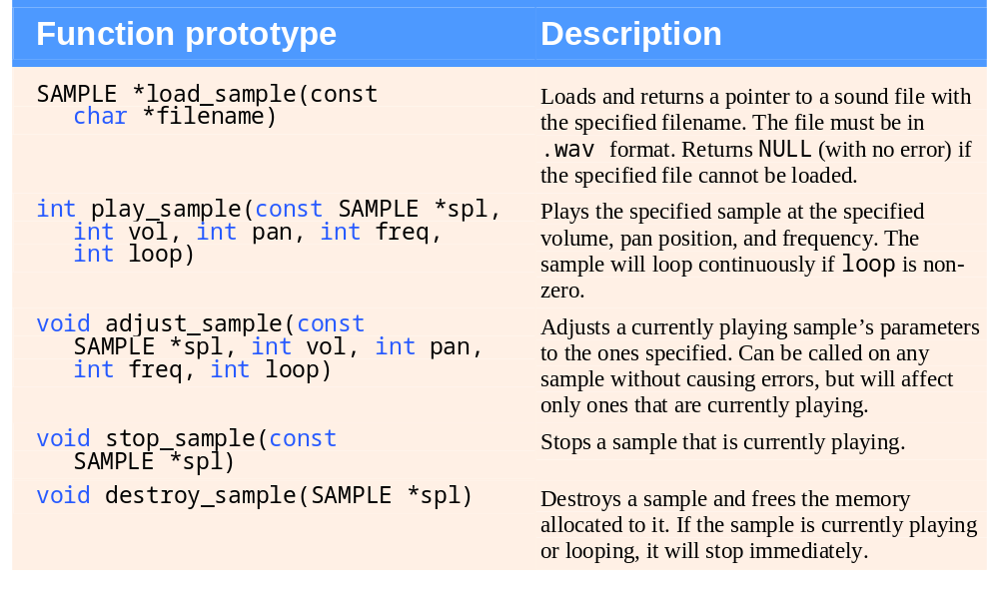
Fig. 15.8 | Important SAMPLE functions.

Slide 42
15.6 Importing and Playing Sounds
install_sound
  Must be called before any sounds can be played
  Takes three arguments—two integers and one string
  First two arguments specify what sound card drivers Allegro should use to play sounds
    Should be passed the “magic drivers” DIGI_AUTODETECT and MIDI_AUTODETECT
  Third argument is obsolete in current version of Allegro; should be passed NULL
    Originally loaded a .cfg file that told Allegro how sounds should be played

Slide 43
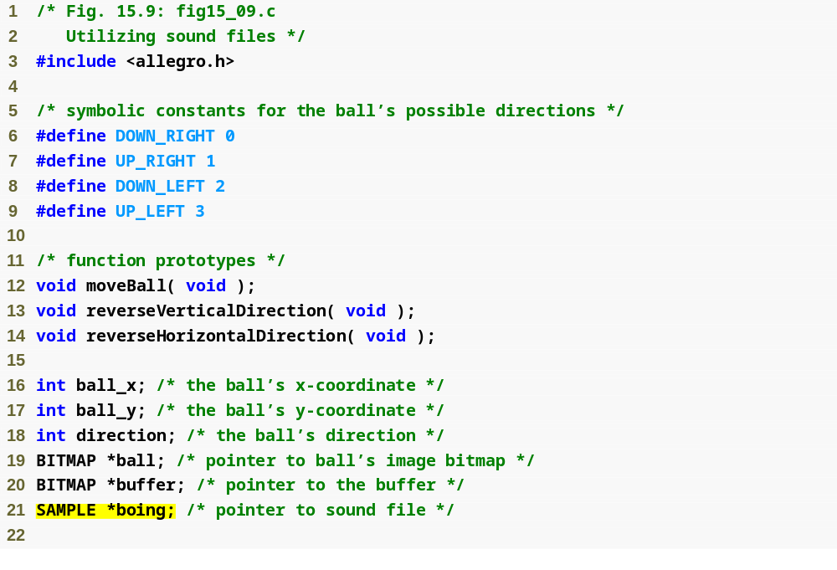
Outline
fig15_09.c
(1 of 5 )
boing sample is defined as a global variable

Slide 44
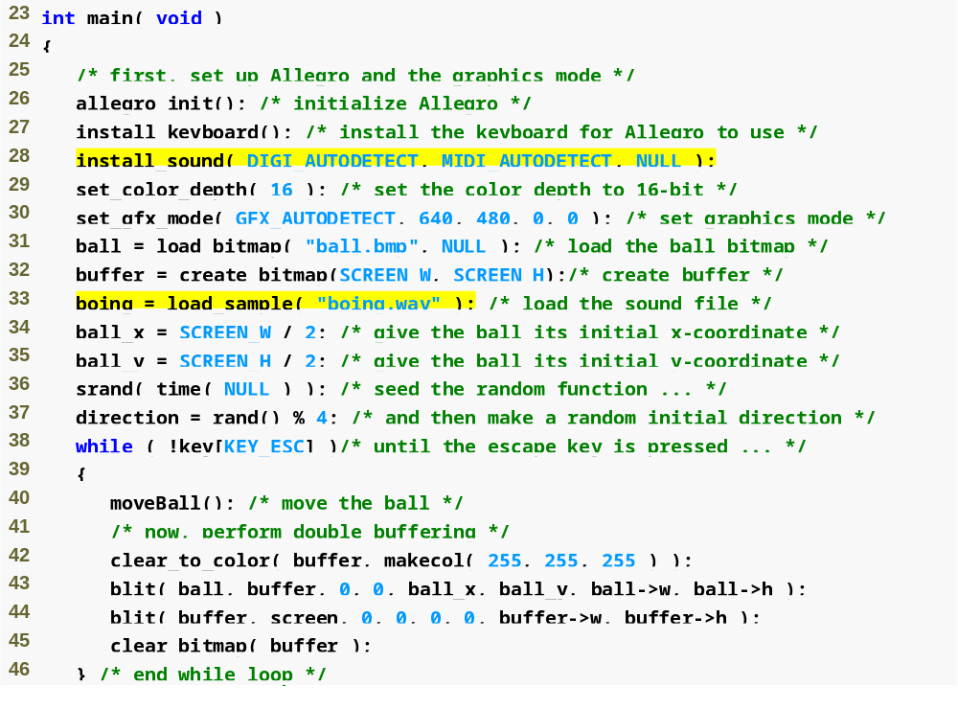
Outline
install_sound must be called to play sounds
fig15_09.c
(2 of 5 )
load_sample loads sound data from a file

Slide 45
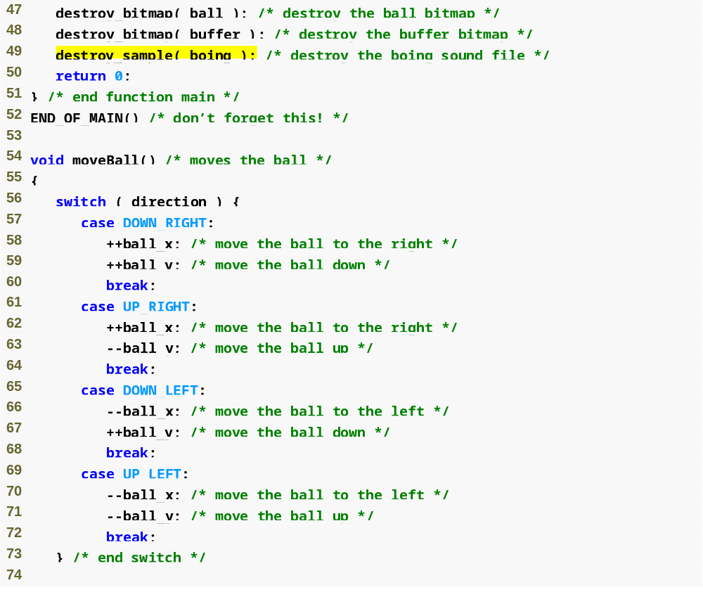
Outline
Samples should be destroyed when they are no longer needed
fig15_09.c
(3 of 5 )

Slide 46
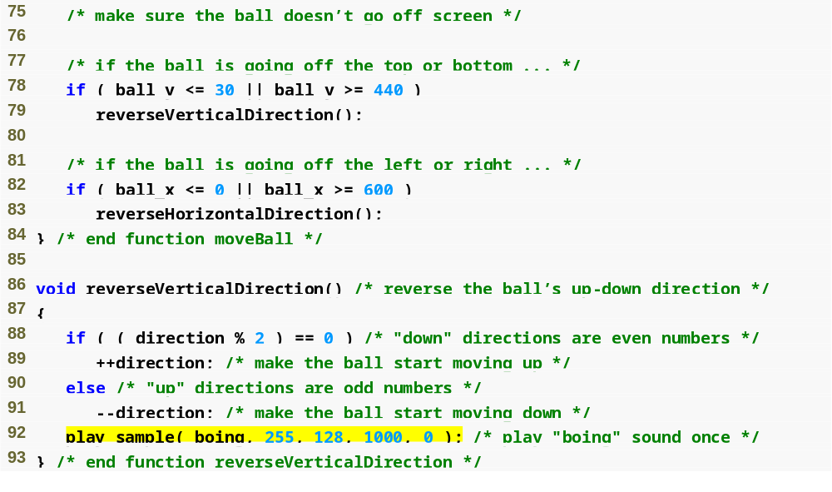
Outline
fig15_09.c
(4 of 5 )
Sample is played when the ball hits a wall

Slide 47
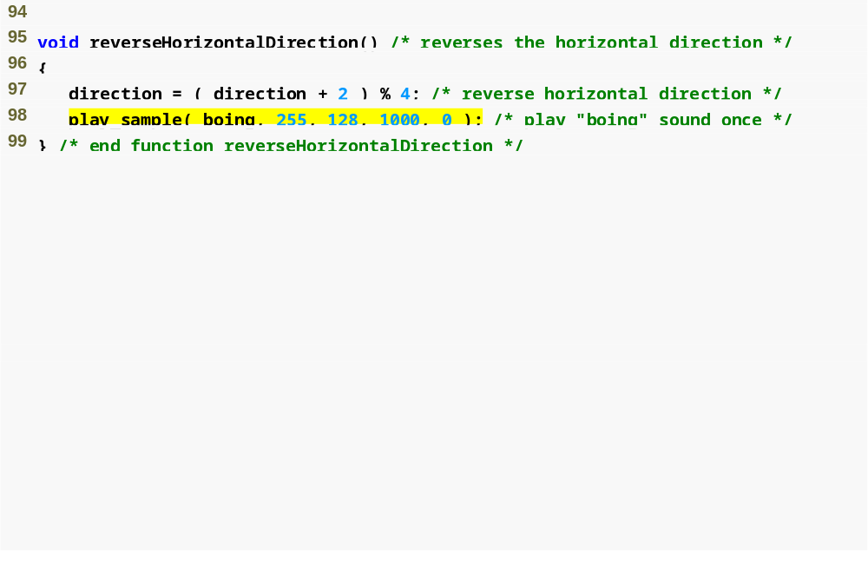
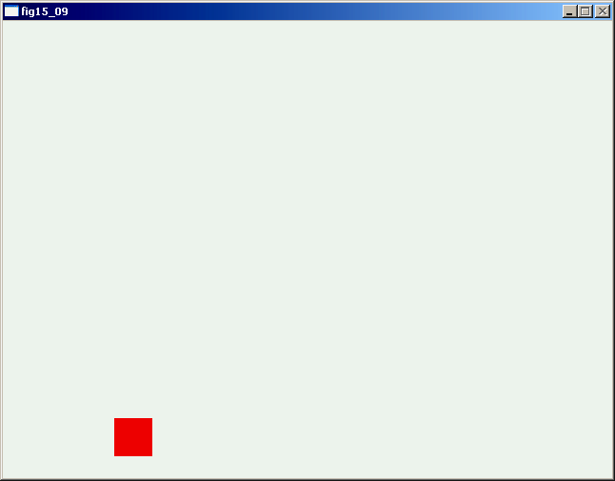
Outline
fig15_09.c
(5 of 5 )
Sample is played when the ball hits a wall

Slide 48
15.7 Keyboard Input
Keyboard Input
  For a game to be called a game, the user must be able to interact with it somehow
install_keyboard
  Allows Allegro to receive and understand keyboard input
  Takes no arguments
  Must be called before keyboard input can be used in a program

Slide 49
15.7 Keyboard Input
key array
  Array of integers that stores the state of each key on the keyboard
  Each key has a specific index in the array
  If a key is not being pressed, its value in the array will be 0; otherwise, it will be non-zero
Keyboard symbolic constants
  Allegro defines a symbolic constant for each key that corresponds to its index in the key array
    The constant for the A key is KEY_A
    The constant for the spacebar is KEY_SPACE
  For example, the value of key[KEY_SPACE] will be 0 if the spacebar is not being pressed, and non-zero if it is
  if statements can be used to check if keys are being pressed

Slide 50
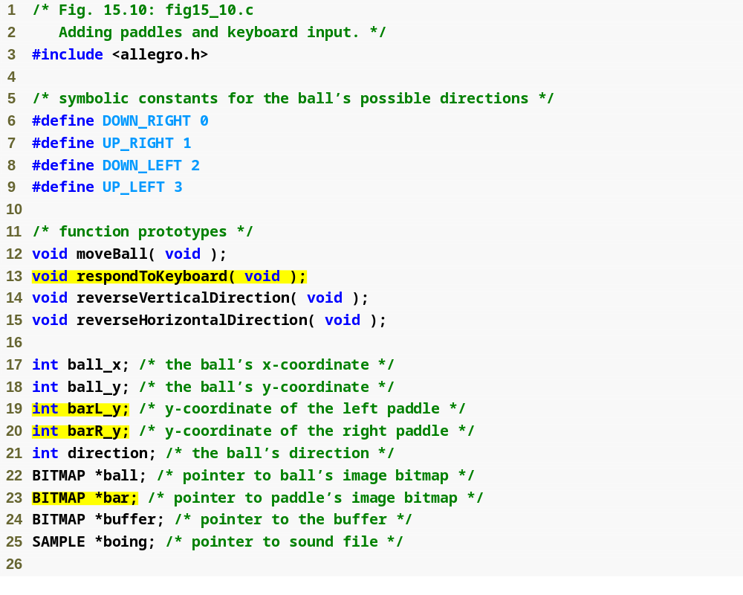
Outline
fig15_10.c
(1 of 7 )
New function has been added that checks if keys are being pressed
We are now adding paddles to the Pong game, so their bitmaps and coordinates must be stored

Slide 51
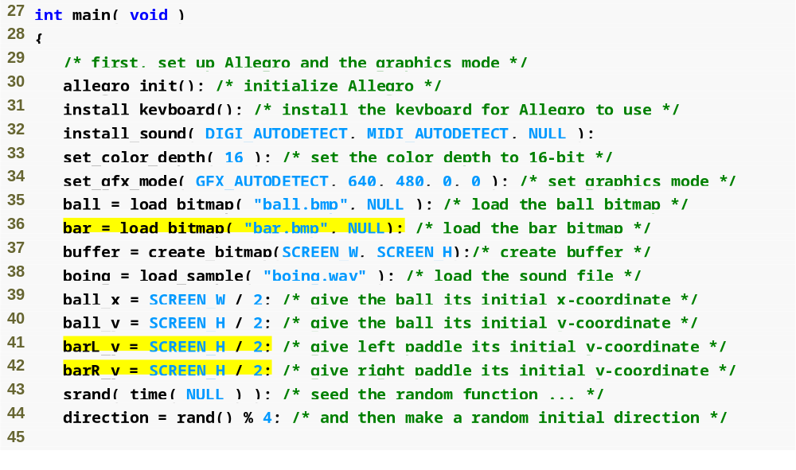
Outline
fig15_10.c
(2 of 7 )
The paddle’s image is loaded
The two paddles are then given their initial coordinates

Slide 52
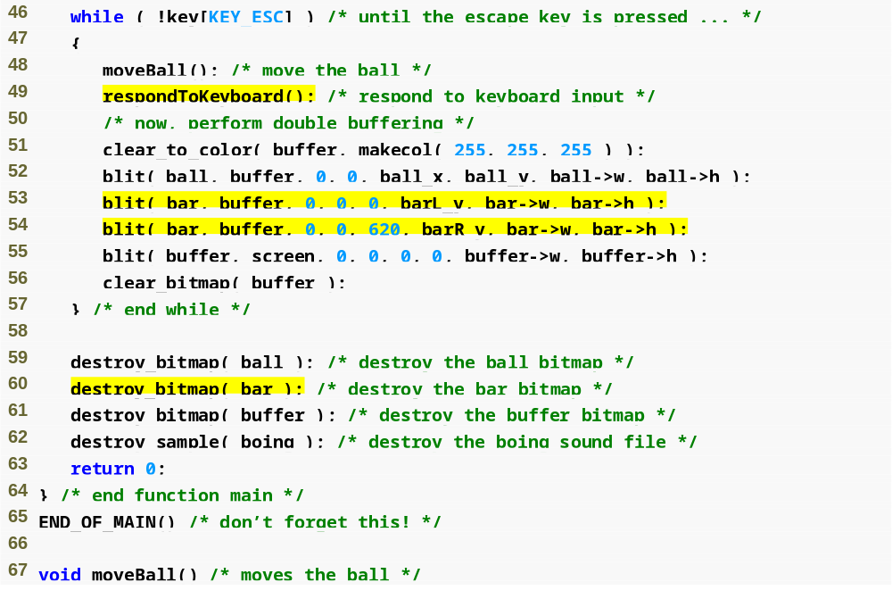
Outline
respondToKeyboard function is called in main while loop
fig15_10.c
(3 of 7 )

Slide 53
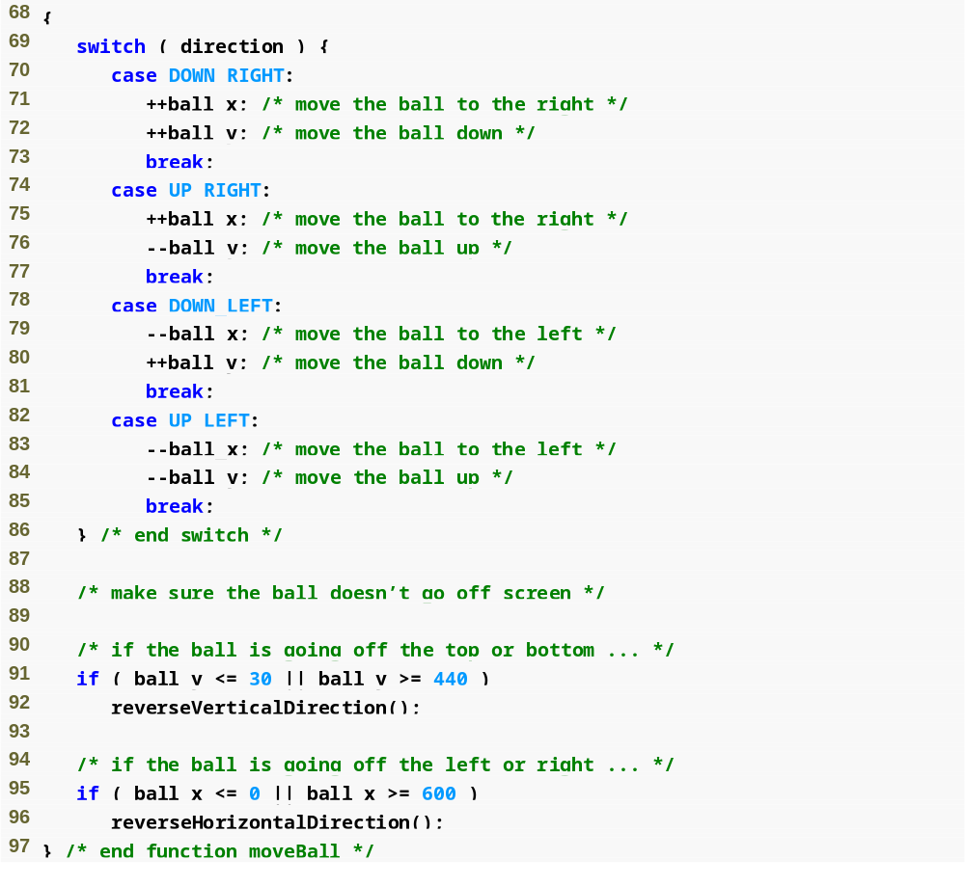
Outline
fig15_10.c
(4 of 7 )

Slide 54
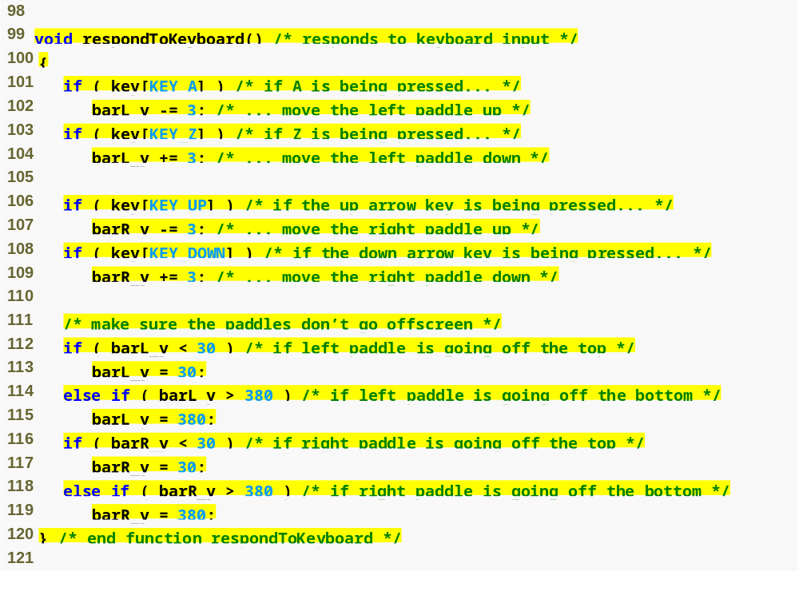
Outline
respondToKeyboard function checks if various keys are being pressed and performs appropriate actions
fig15_10.c
(5 of 7 )
if statements use key array to check if keys are being pressed

Slide 55
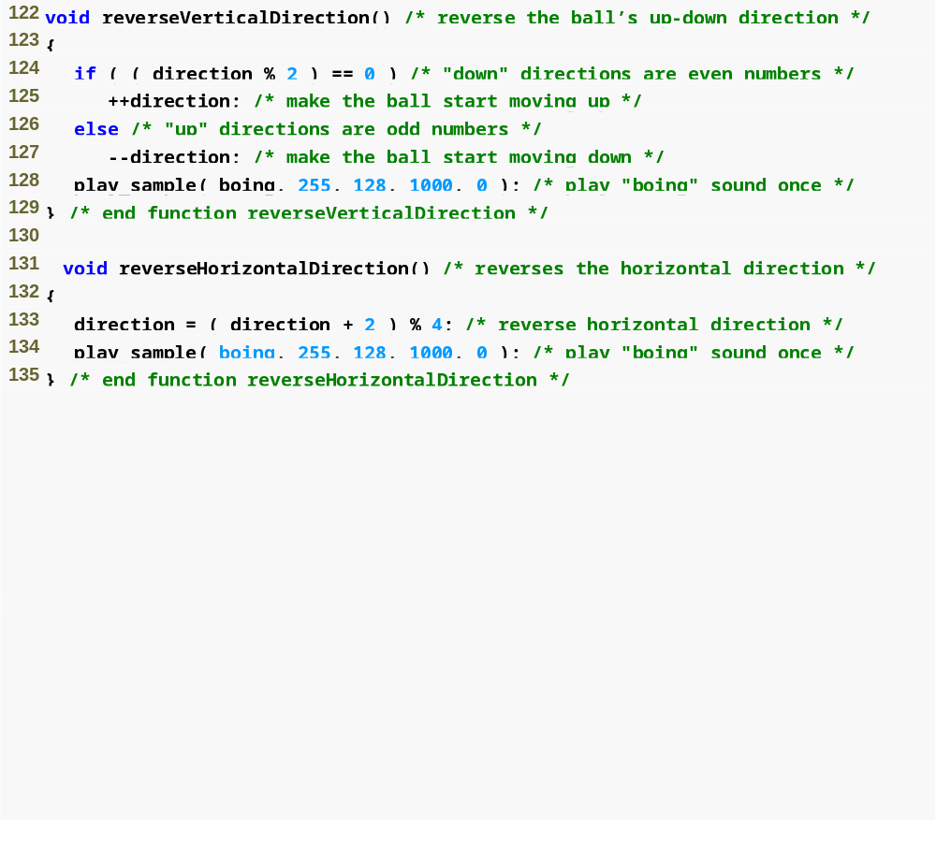
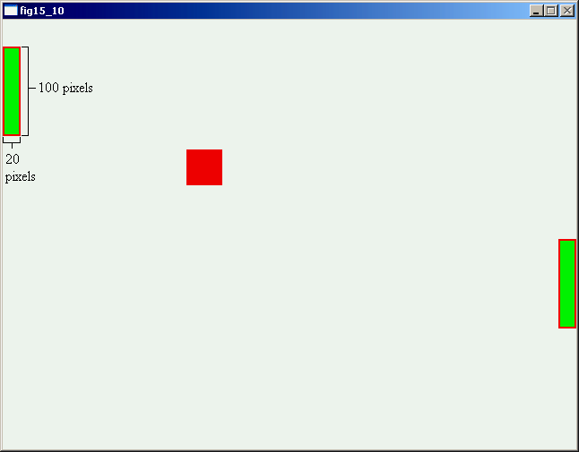
Outline
fig15_10.c
(6 of 7 )

Slide 56

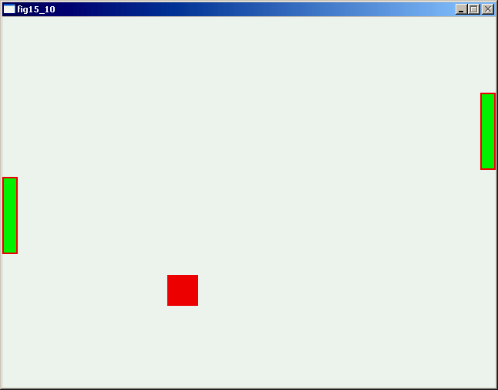
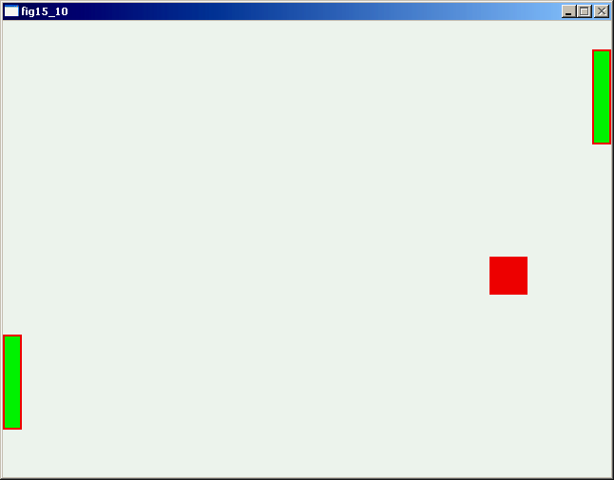
Outline
fig15_10.c
(7 of 7 )

Slide 57
15.8 Fonts and Displaying Text
Displaying Text
  In all games, it is necessary for the game to communicate with the user in some way
Fonts
  Allegro can display text on the screen, but it must be told in which font the text should be displayed
  As with bitmaps and samples, Allegro defines a FONT* type that points to font data in memory
font symbolic constant
  The symbolic constant font corresponds to Allegro’s default font—can be used in place of any FONT* variable

Slide 58
15.8 Fonts and Displaying Text
load_font
  Loads a font file into memory
  Takes two arguments—a file name and a palette
    As with bitmaps, the palette is usually passed as NULL
  Returns a FONT* or NULL if the font cannot be loaded
destroy_font
  Destroys a font and frees its memory for later use
  Takes a FONT* as an argument
  Remember to destroy fonts once they are no longer needed

Slide 59
15.8 Fonts and Displaying Text
Displaying Text
  Once a font has been loaded, one must use the textprintf_ex function to display the text on the screen
textprintf_ex
  Displays a string on the screen in the specified font
  Takes at least seven arguments—a BITMAP*, a FONT*, four integers, and a format control string
  First argument specifies the bitmap on which the text should be drawn
  Second argument specifies the font in which the text should be drawn

Slide 60
15.8 Fonts and Displaying Text
textprintf_ex
  Third and fourth arguments specify the x- and y-coordinates at which the text should begin
  Fifth and sixth arguments specify the foreground and background colors of the text being printed
    Use makecol function to determine the correct values
    Use a value of -1 to specify a transparent color
  Seventh argument specifies the string to be printed
    This argument is a format control string, so conversion specifiers can be placed in it
    If any conversion specifiers are present, arguments should be added following the string that specify their values

Slide 61
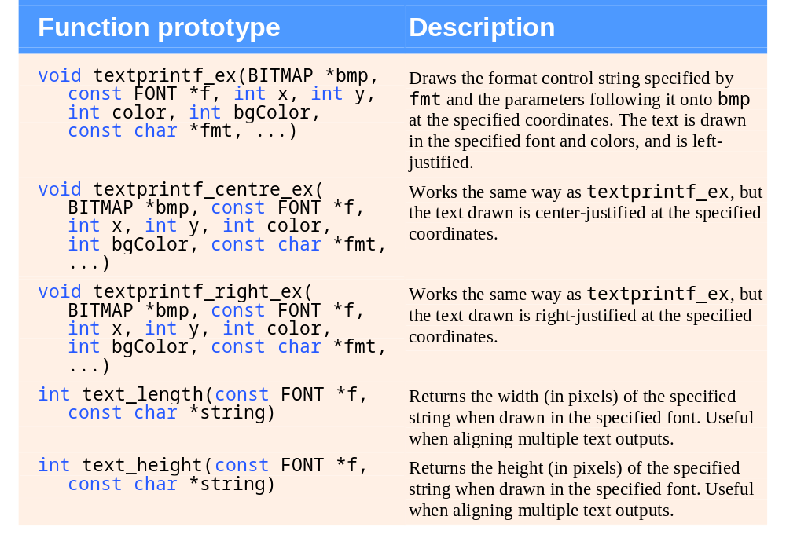
Fig. 15.11 | Functions that are useful for drawing text onto a bitmap.

Slide 62
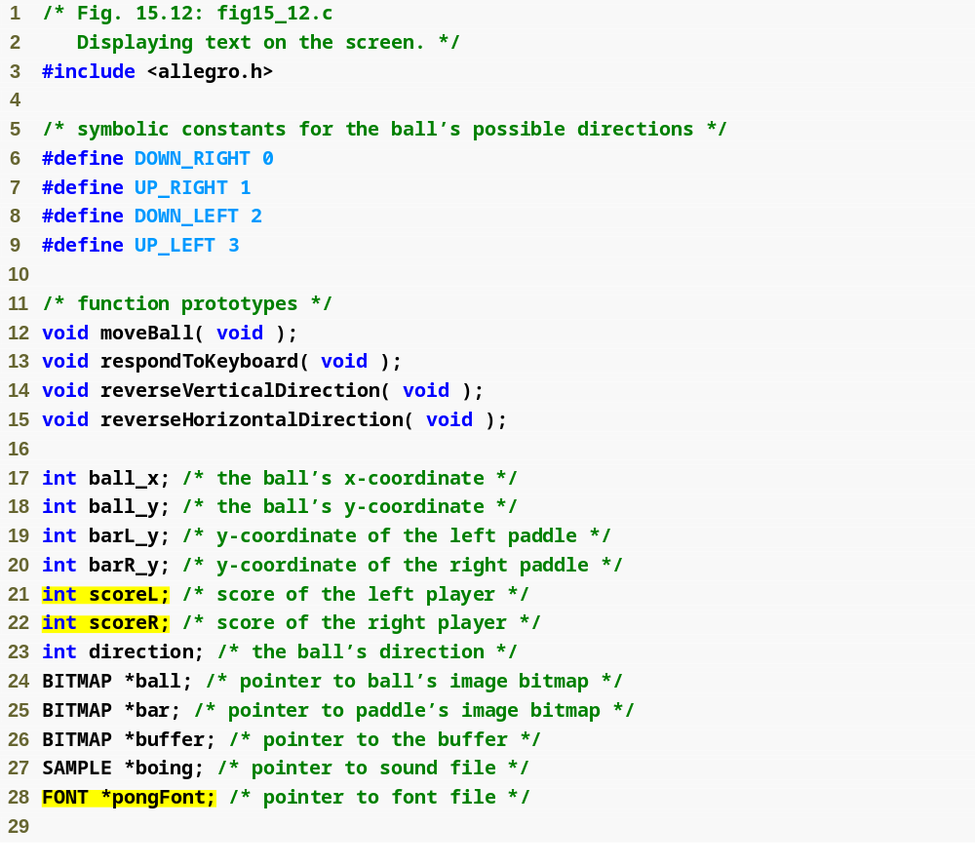
Outline
fig15_12.c
(1 of 6 )
We now add a scoreboard to our Pong game, so there must be variables that store each player’s score
FONT* variable will point to the data of our font in memory

Slide 63
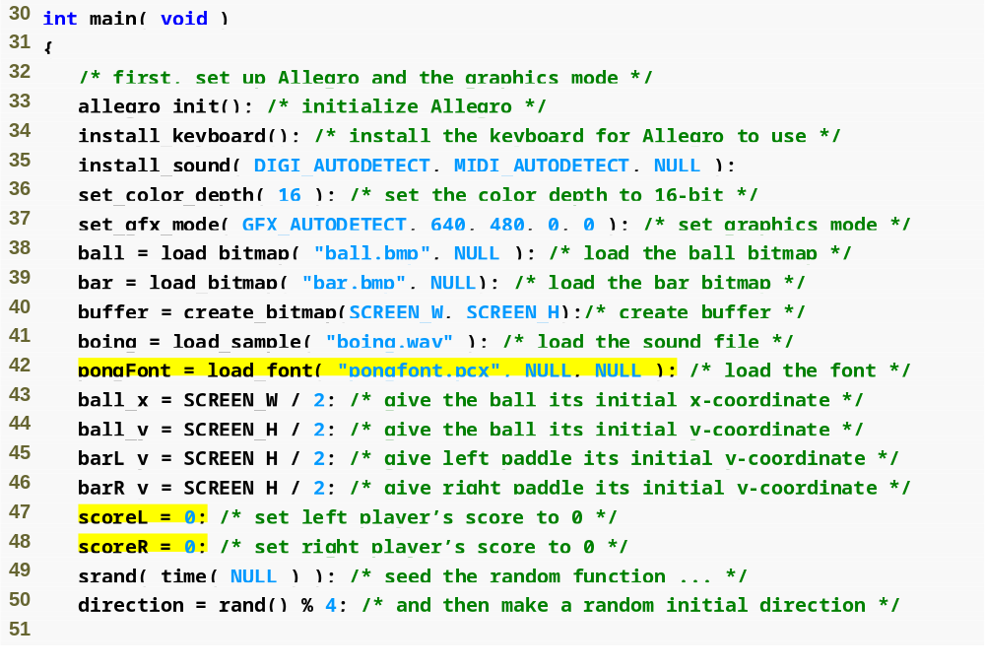
Outline
fig15_12.c
(2 of 6 )
load_font function loads font data into memory

Slide 64
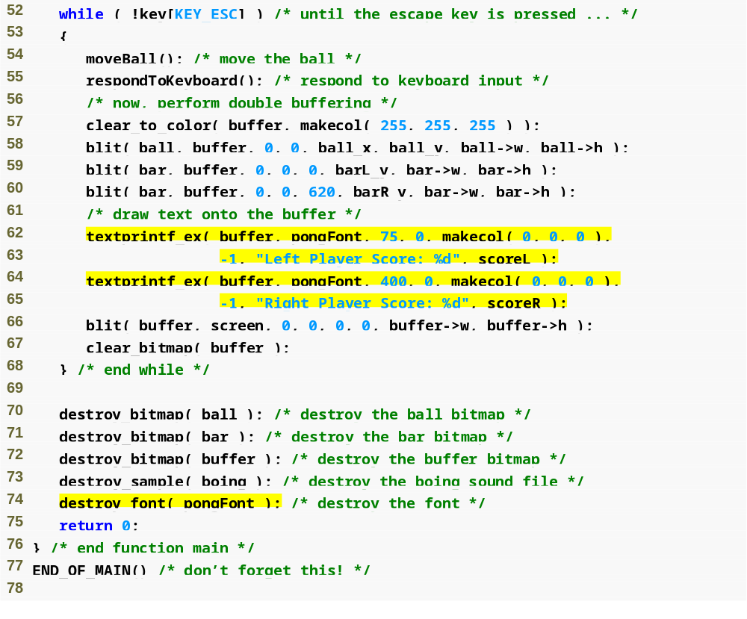
Outline
fig15_12.c
(3 of 6 )
textprintf_ex function displays text on the screen

Slide 65
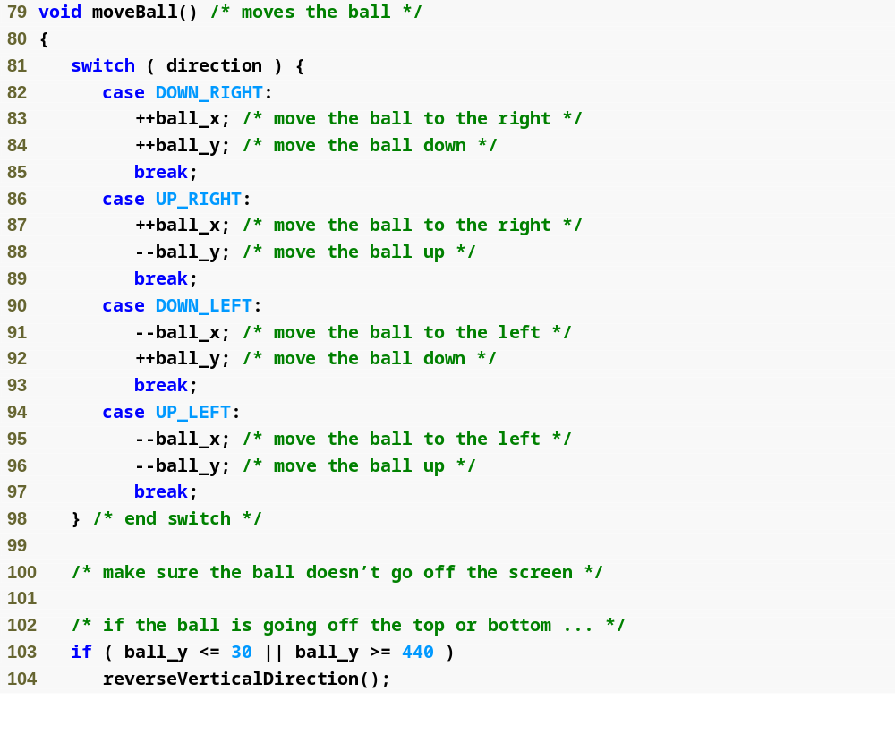
Outline
fig15_12.c
(4 of 6 )

Slide 66
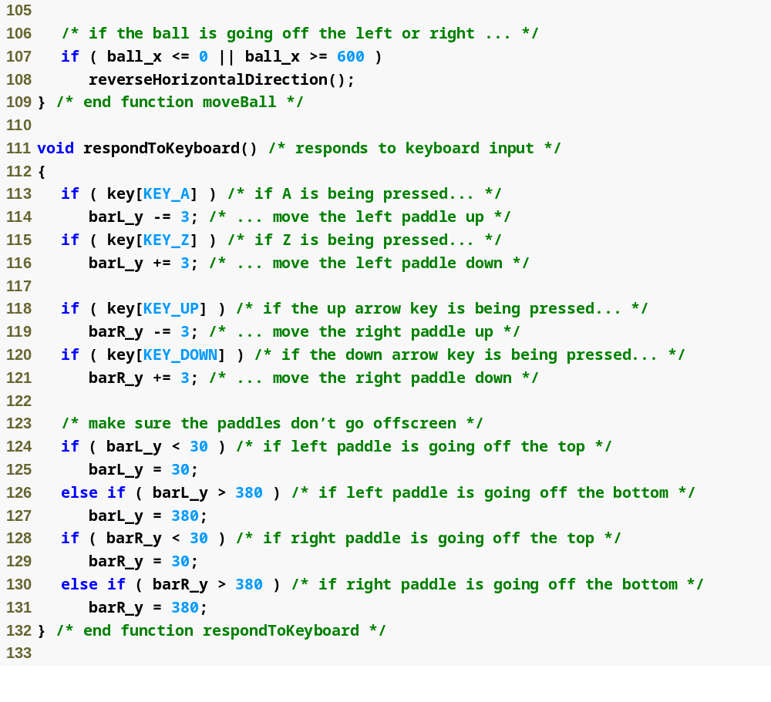
Outline
fig15_12.c
(5 of 6 )

Slide 67
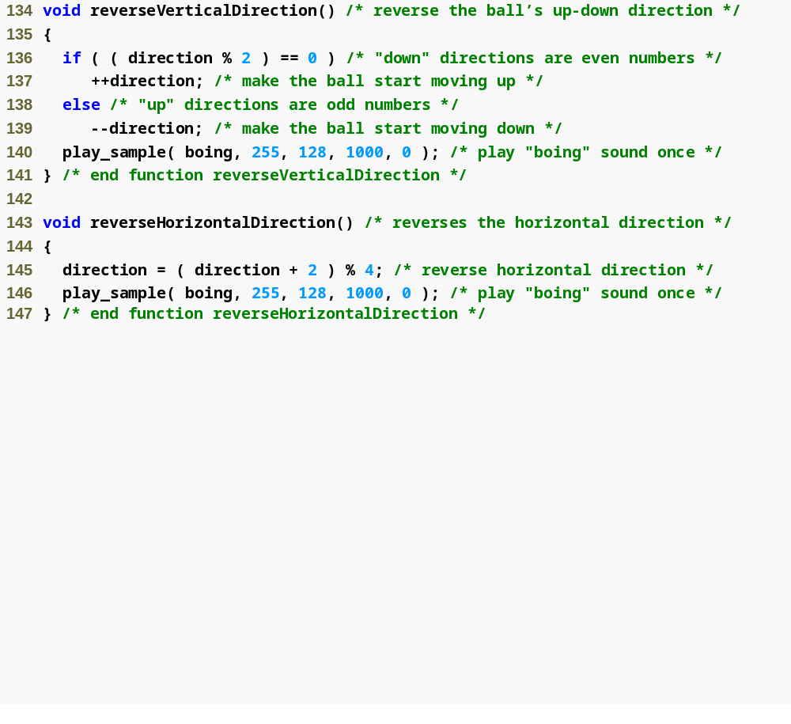
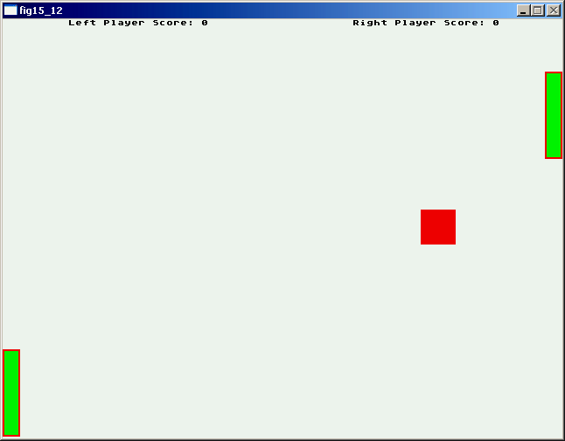
Outline
fig15_12.c
(6 of 6 )

Slide 68
15.9 Implementing the Game of Pong
Unresolved Issues
  There are two issues we have to resolve before our Pong game can be considered complete
    Making the ball bounce off the paddles
    Creating a boundary between the scoreboard and the game
Making the ball bounce off the paddles
  In our current Pong game, the paddles do not stop the ball
  We must make the ball reverse its direction if it hits a paddle
  Since we know the dimensions of the ball and paddle, we can use if statements to determine if they are touching

Slide 69
15.9 Implementing the Game of Pong
Creating a boundary
  In our current Pong game, there is a boundary between the scoreboard and the game, but it is not visible
  We use Allegro’s line function to create this boundary
line function
  Draws a line onto a bitmap
  Takes six arguments—a BITMAP* and five integers
  First argument specifies the bitmap onto which the line should be drawn
  Second and third arguments specify the x- and y-coordinates of the point where the line starts
  Fourth and fifth arguments specify the x- and y-coordinates of the point where the line ends
  Sixth argument specifies the line’s color—use makecol

Slide 70
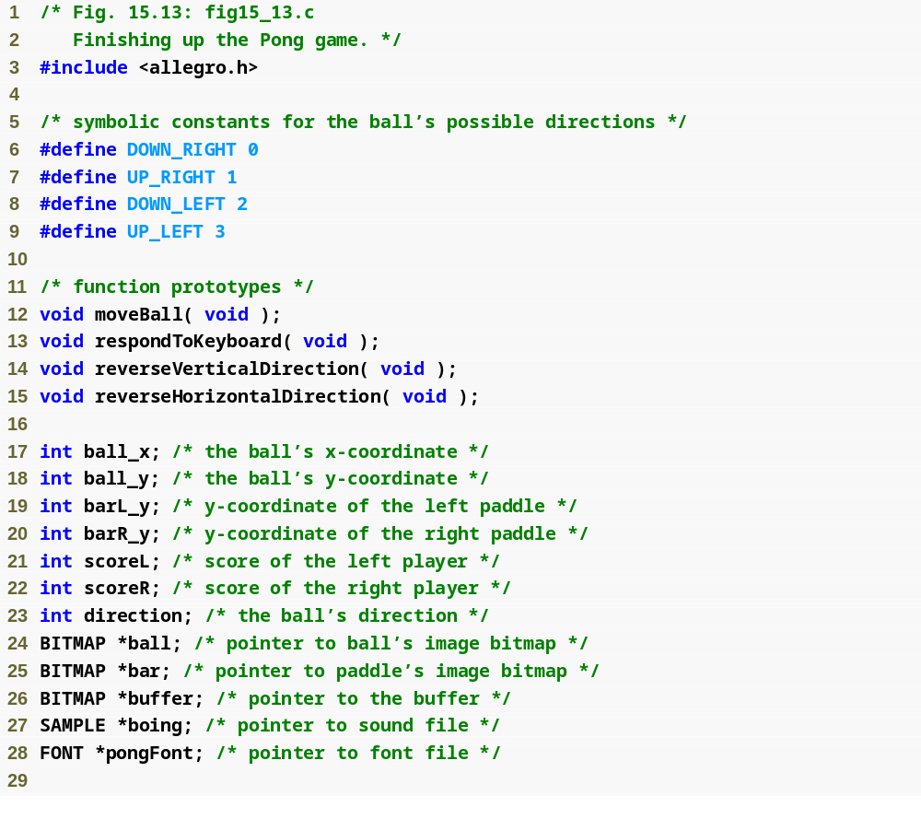
Outline
fig15_13.c
(1 of 9 )

Slide 71
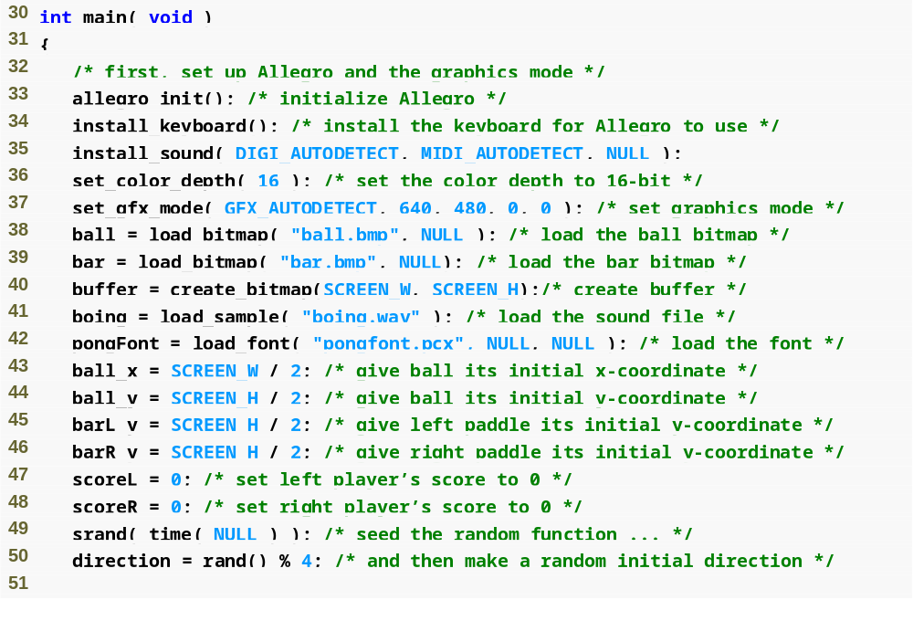
Outline
fig15_13.c
(2 of 9 )

Slide 72
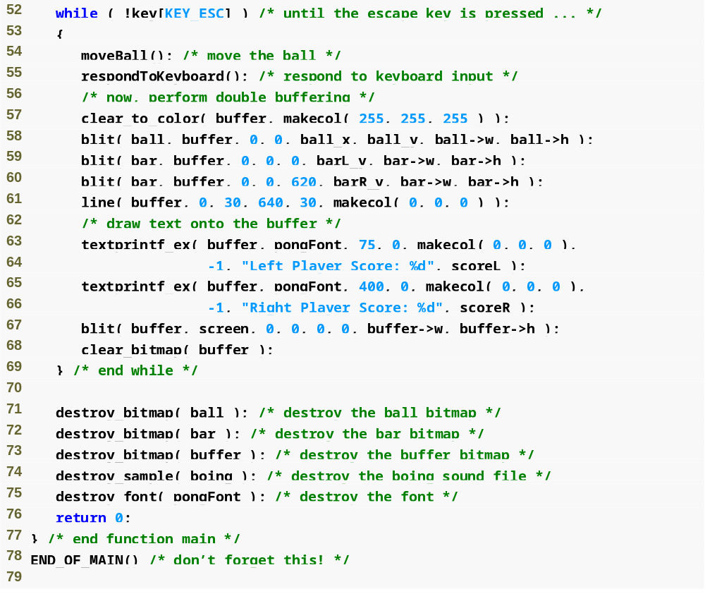
Outline
fig15_13.c
(3 of 9 )
line function draws a line onto the buffer

Slide 73
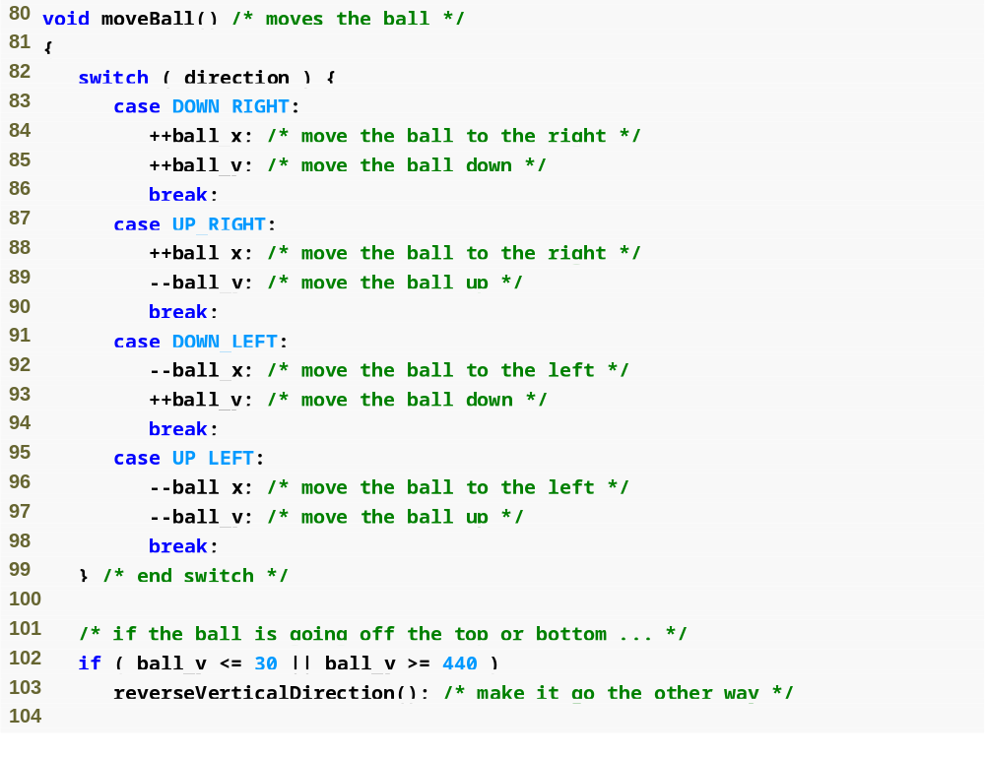
Outline
fig15_13.c
(4 of 9 )

Slide 74
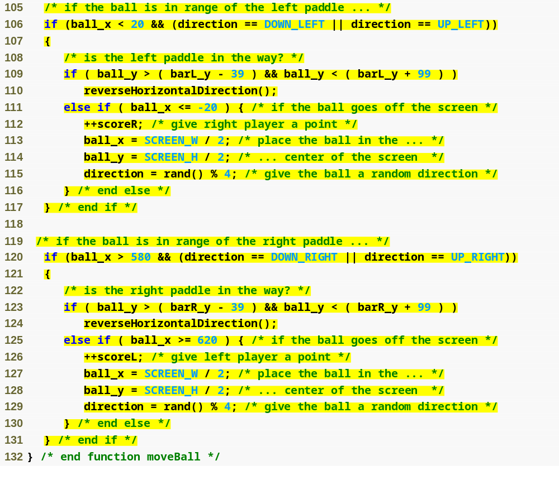
Outline
fig15_13.c
(5 of 9 )
If the ball is moving off the side of the screen, the program checks if the paddle is in the way. If it is, the ball bounces; if not, the player on the other side gets a point and the ball is placed in the center of the screen.

Slide 75
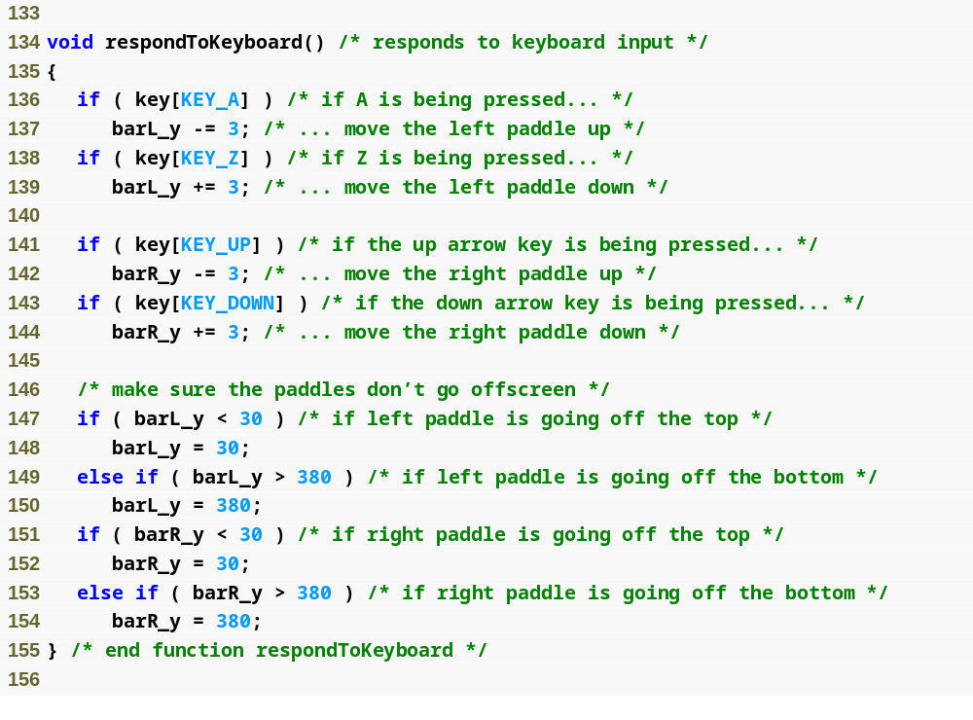
Outline
fig15_13.c
(6 of 9 )

Slide 76
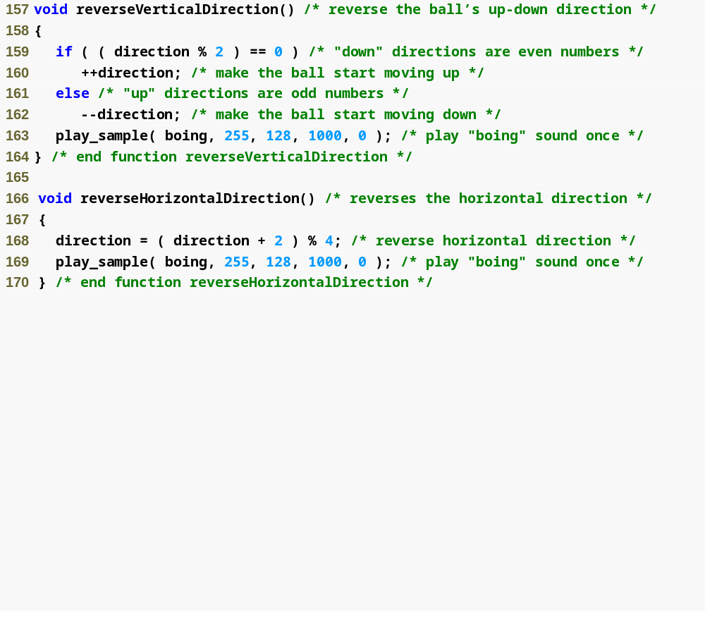
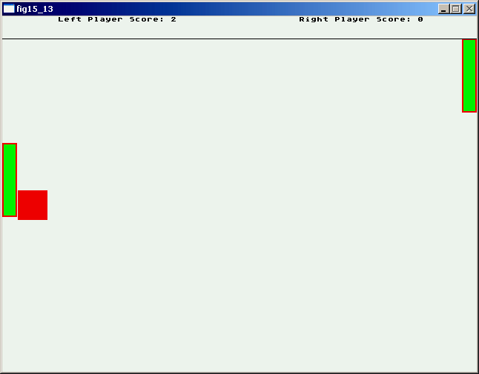
Outline
fig15_13.c
(7 of 9 )

Slide 77

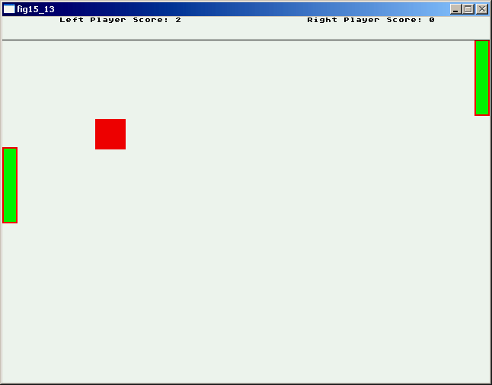

Outline
fig15_13.c
(8 of 9 )

Slide 78


Outline
fig15_13.c
(9 of 9 )

Slide 79
15.10 Timers in Allegro
Timers
  In our current Pong game, there is nothing regulating how quickly the game runs
    On very fast systems the game may run too quickly to be playable
  Allegro’s timers allow us to control how often certain functions are called and how quickly our game runs
install_timer
  Must be called before any timers can be used
  Takes no arguments
  Can be cancelled by calling remove_timer function, which will remove all timers that are running

Slide 80
15.10 Timers in Allegro
install_int
  Installs a timer that calls a specified function at regular intervals
  Takes two arguments—a function pointer and an integer
  First argument specifies the function to be called
  Second argument specifies the interval (in milliseconds) at which the function should be called
  Allegro can have up to 16 timers running at once
  Returns 0 if the timer is installed successfully, or a non-zero value if the function fails

Slide 81
15.10 Timers in Allegro
Timers are not variables
  Unlike bitmaps, sounds, and fonts, timers are not stored in variables
  Once a timer is installed it will run in the background
  Allegro identifies each timer by the function it calls
remove_int
  Removes a timer previously installed by install_int
  Takes one argument—the function called by the timer to be removed

Slide 82
15.10 Timers in Allegro
Other notes
  Any variable that can be modified in a function called by a timer must be given the volatile qualifier
    Because of the way timers are programmed, some compilers may not understand that a variable can be changed by a timer, and may optimize the code at compile time in a way that removes the variable’s modification
  On systems running DOS or Mac OS 9 and below, the memory of variables and functions used by timers must be “locked” for the timers to work correctly
    Not necessary on current systems
    Detailed instructions on Allegro website

Slide 83

Outline
fig15_14.c
(1 of 7 )
Variables modified in any function called by a timer must be given the volatile qualifier

Slide 84

Outline
fig15_14.c
(2 of 7 )
install_timer function must be called before timers can be used
moveBall function will be called every 5 milliseconds
respondToKeyboard function will be called every 10 milliseconds

Slide 85

Outline
fig15_14.c
(3 of 7 )
remove_int function removes currently running timers
Note that the calls to moveBall and respondToKeyboard have been removed from the while loop—otherwise they would be called by both the timers and the while loop

Slide 86

Outline
fig15_14.c
(4 of 7 )

Slide 87

Outline
fig15_14.c
(5 of 7 )

Slide 88

Outline
fig15_14.c
(6 of 7 )

Slide 89


Outline
fig15_14.c
(7 of 7 )

Slide 90
15.11 The Grabber and Allegro Datafiles
Datafiles
  Every external file needed by an Allegro program must be loaded and later destroyed at program’s end
    Simple when there is a small number of external files, but becomes very tedious when the number rises
  Allegro datafiles take data of multiple external files and store it in one place
  An Allegro program can load one datafile and gain access to the data of multiple external files

Slide 91
15.11 The Grabber and Allegro Datafiles
Grabber
  Datafiles are not very useful if we can’t make our own
  The Allegro package contains a program called the grabber which is used to create datafiles
  Executing the grabber program will cause the screen on the next slide to appear

Slide 92

Fig. 15.15 | Allegro’s grabber utility.

Slide 93
15.11 The Grabber and Allegro Datafiles
Four main areas of grabber window
  Top area
    Contains information about the datafile being edited
  White area in bottom left
    Lists objects that the datafile contains
    Currently empty as we have not loaded any external files
  Gray window in top right
    Contains information about the currently selected object
    No object is currently selected, so it is empty
  Bottom right area
    Displays picture of currently selected object (if the object can be displayed as a picture—e.g. sounds cannot be displayed)

Slide 94
15.11 The Grabber and Allegro Datafiles
Adding new objects to a datafile
  First, we will add our ball bitmap to the datafile
  Highlight “New” in the “Object” menu and a list of object types appears
  Select “Bitmap”
  Screen should now look like next slide

Slide 95

Fig. 15.16 | Adding a bitmap to a datafile.

Slide 96
15.11 The Grabber and Allegro Datafiles
Applying data to an object
  A new bitmap object has been created, but currently it is blank
  To apply image data to the object, we must first read in a bitmap from an external file
  Select “Read Bitmap” from “File” menu and import the ball.bmp file
  Ball bitmap will appear on screen; click to return to main grabber screen
  Next, select “Grab” from object menu
  Screen on next slide will appear

Slide 97

Fig. 15.17 | Applying an imported bitmap to an object.

Slide 98
15.11 The Grabber and Allegro Datafiles
Applying image data to a bitmap object
  Grabber is asking what part of imported bitmap should be applied to BALL object
  Drag a box over entire bitmap and release the mouse
  Screen on next slide will appear

Slide 99

Fig. 15.18 | A complete imported object.

Slide 100
15.11 The Grabber and Allegro Datafiles
Importing bitmaps
  BALL object has been successfully created
  Repeat process with paddle bitmap to add it to the datafile as well
Importing other objects
  To add sound files or fonts to the datafile, choose the respective object from the “New” list in “Object” menu
  Once object has been created, simply select “Grab” from object menu and select the external file to load
    No need to “read” file as with bitmaps
  Once all objects have been created, screen on next slide should appear

Slide 101

Fig. 15.19 | The grabber window after importing all of our objects.

Slide 102
15.11 The Grabber and Allegro Datafiles
Saving the datafile
  Before choosing “Save” from the file menu, type pong.h into the “Header” field at the top of the grabber window
  This will make the grabber save a header file alongside the datafile
    The usage of this header will be explained shortly
  Then save the datafile in the same folder as the Pong program

Slide 103
15.11 The Grabber and Allegro Datafiles
Loading datafiles into a program
  Just as Allegro defines the BITMAP*, SAMPLE*, and FONT* variable types to point to image, sound, and font data, it also defines the DATAFILE* type to point to datafile objects in memory
  Datafiles are loaded with load_datafile function, which takes a filename, and removed from memory with the unload_datafile function, which takes a DATAFILE* variable
  destroy_datafile function is not defined by Allegro

Slide 104
15.11 The Grabber and Allegro Datafiles
Accessing objects in a datafile
  Allegro considers a DATAFILE* variable loaded into a program to be an array of objects
  Each object’s index in the array corresponds to the order it was imported into the grabber
  First object imported has index 0, second object has index 1, and so on
  If there are many objects in the datafile, remembering each object’s index can be difficult
  However, take a look at the header file we saved earlier

Slide 105

Outline

Slide 106
15.11 The Grabber and Allegro Datafiles
The header file
  Defines a symbolic constant for each object that corresponds to that object’s index in the array
  Each symbolic constant is the name that was given to the object when it was imported into the datafile
Accessing objects in the datafile
  If the datafile myDatafile has been loaded into the program, an object in it can be accessed with the code myDatafile[i].dat, where i is the object’s index
  C considers any object accessed from a datafile to be of type void *, so they cannot be dereferenced

Slide 107

Outline
pong.h header included to help with accessing datafile objects
fig15_21.c
(1 of 7 )
DATAFILE* object replaces all external files (the buffer is not external)

Slide 108

Outline
fig15_21.c
(2 of 7 )
load_datafile function loads a datafile into the program

Slide 109

Outline
fig15_21.c
(3 of 7 )
unload_datafile function removes datafile from memory

Slide 110

Outline
fig15_21.c
(4 of 7 )

Slide 111

Outline
fig15_21.c
(5 of 7 )

Slide 112

Outline
fig15_21.c
(6 of 7 )

Slide 113


Outline
fig15_21.c
(7 of 7 )

Slide 114
15.12 Other Allegro Capabilities
Drawing primitives
  Allegro can draw several types of simple polygons without external graphics
Playing MIDI music files
Playing .fli format animations in programs
Displaying 3D graphics–very complex
Information on these capabilities in Allegro’s online manual at www.allegro.cc/manual

